Slide 1
Research Services Capability Framework
Developing a Researcher-Facing Librarian Capability Framework
Shiobhan Smith
University of Otago
shiobhan.smith@otago.ac.nz
Notes:
Introduce who I am, my background, and current role
-Professional qualifications are specifically in LIS and teaching (have others)
-Previous Subject Librarian
-Manage Research Support Unit
-Experienced great changes in the expectations, focus, and tasks required to support researchers

Slide 2
Aims and scope of this workshop
Seek to learn about what capabilities library directors and managers value in researcher-facing librarians.
Better understand the struggles of directors and managers to recruit and/or develop librarians working in “inside-out” categories.
Provide insight into how to structure the capability framework so that it is useful for directors and managers.

Slide 3
Capability or Competency?
Often used as synonyms
In the context of this framework:
Capability is built on competency.
Competency is what you can do in the here and now.
Capability is the ability to grow your competencies into the future.
To build a capability framework I have to understand the competencies it is being built on.
Notes:
Competency + capacity = capability

Slide 4
Setting the scene
The framework will encompass Lorcan Dempsey’s “inside-out” concept:
“Creation happens in a digital environment, with an interest in the process, as well as the products, of research and learning. Libraries increasingly support the creation, curation and discoverability of institutional creations (research data, preprints, scholarly profiles, academic profiles, digitized special collections, …). The university wishes to share these materials with the rest of the world.”
Dempsey, L. (2016). Library collections in the life of the user: two directions. LIBER Quarterly, 26(4). doi:10.18352/lq.10170
Notes:
Traditionally outside-in
Facilitated collection

Slide 5
Setting the scene
The framework will try to capture functional and [some] job-specific competencies:
Functional (Job Family):
“Characteristics shared by different positions within an organization (i.e., a group of related or similar jobs). Only those members of an organization in these positions are expected to possess these competencies.”
Job specific:
“Characteristics that apply only to specific positions within the organization. Only those people in the position are expected to possess these competencies.”
Catano, V. M., Hackett, R. D., & Wiesner, W. H. (2019). Job analysis and competency models. In Recruitment and selection in Canada (pp. 113-178). Toronto, Ontario: Nelson Education.

Slide 6
Setting the scene
Who is a researcher-facing librarian?
In the context of this workshop, researcher-facing librarians work in university libraries on tasks that are primarily focused on interacting with researchers to support their research.
Researcher-facing librarians are increasingly being required to upskill and engage with the research process at deeper, more technical, levels.
They may be repurposed or new roles.
Inside-out services should represent a reasonable proportion of the services they engaged in but they may have other tasks that fall into other categories.
Acknowledge that there are some tasks and services that are ‘grey’.
Notes:
Grey example – Subject Guide about RDM.

Slide 7

Activity one
Brainstorm by Nick Youngson CC BY-SA 3.0 Alpha Stock Images

Slide 8
A researcher-facing librarian would have these skills, knowledge, and abilities…
Essential – every researcher-facing librarian should have these core skills, knowledge, and abilities
Recommended – highly desirable skills, knowledge, and abilities that distinguish proficient researcher-facing librarians
Specialist – skills, knowledge, and abilities unique to a specific role but not necessarily required by all researcher-facing librarians
Other – skills, knowledge, and abilities that researcher-facing librarians have that do not fall into the other three categories
Notes:
Thinking about the role today…

Slide 9
Crystal ball time – in the next 10 years…
Where do you anticipate future growth/need?
Using the new coloured pen circle these
Do you anticipate some of these shifting category e.g. moving from specialist to recommended?
Using the new coloured pen write in brackets the category you anticipate a knowledge/skill/ability will move to e.g. special skill (recommended)
What is currently not listed but will probably become a likely addition in the future?
Using the new coloured pen add these

Slide 10
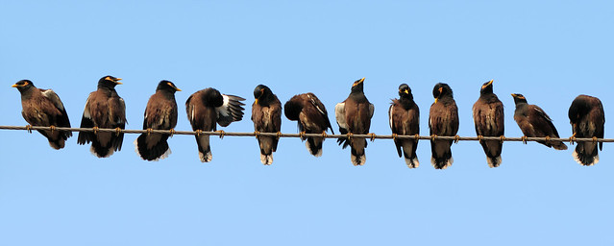
Activity two
Image by wildxplorer CC BY 2.0 Flickr

Slide 11
How can we grow inside-out knowledge/skills/abilities within our teams?
What staff development opportunities do you currently utilize?
What are some barriers to staff development?
What are the benefits and limitations of LIS qualifications?
What level of domain/discipline knowledge is required?
What level of digital literacy is required?
Notes:
8m
5m
3m
2m
1m

Slide 12
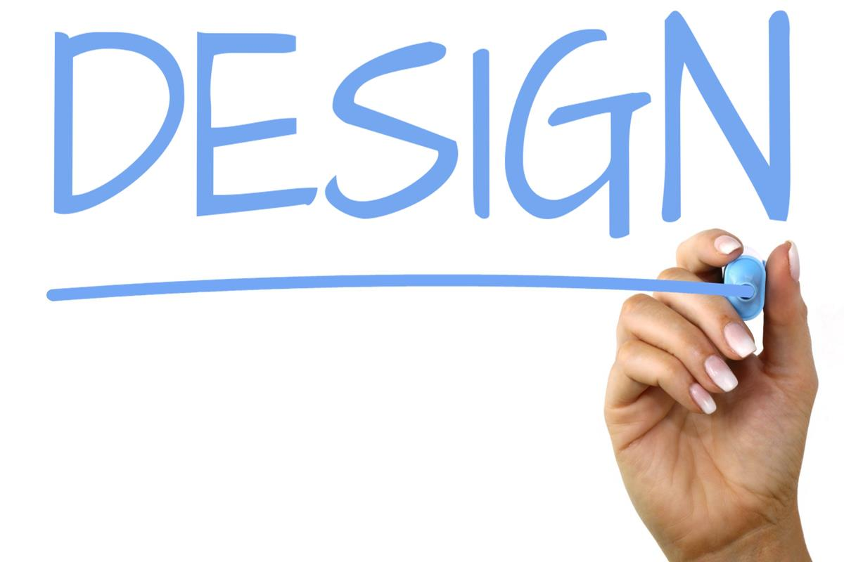
Activity three
Design by Nick Youngson CC BY-SA 3.0 Alpha Stock Images

Slide 13
Designing the bones
How should it be structured?
How simple or complex should it be?
How specific should it be?
Should it have levels within each capability described?
How many?
How should they be labelled?
How descriptive should they be?
How would it be presented?

Slide 14
Kia ora and thank you for attending this workshop.
Before you leave can you please complete a short survey?
Leave your email if you wish to receive a summary of the workshop and/or contribute further.

